Slide 1
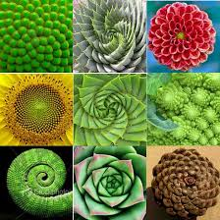
Recursion

Slide 2
Announcements
Midterm + Schedule updates
Midterm covers all material this week.
No lecture day after midterm
Next Monday: Review recursion + MT

Slide 3
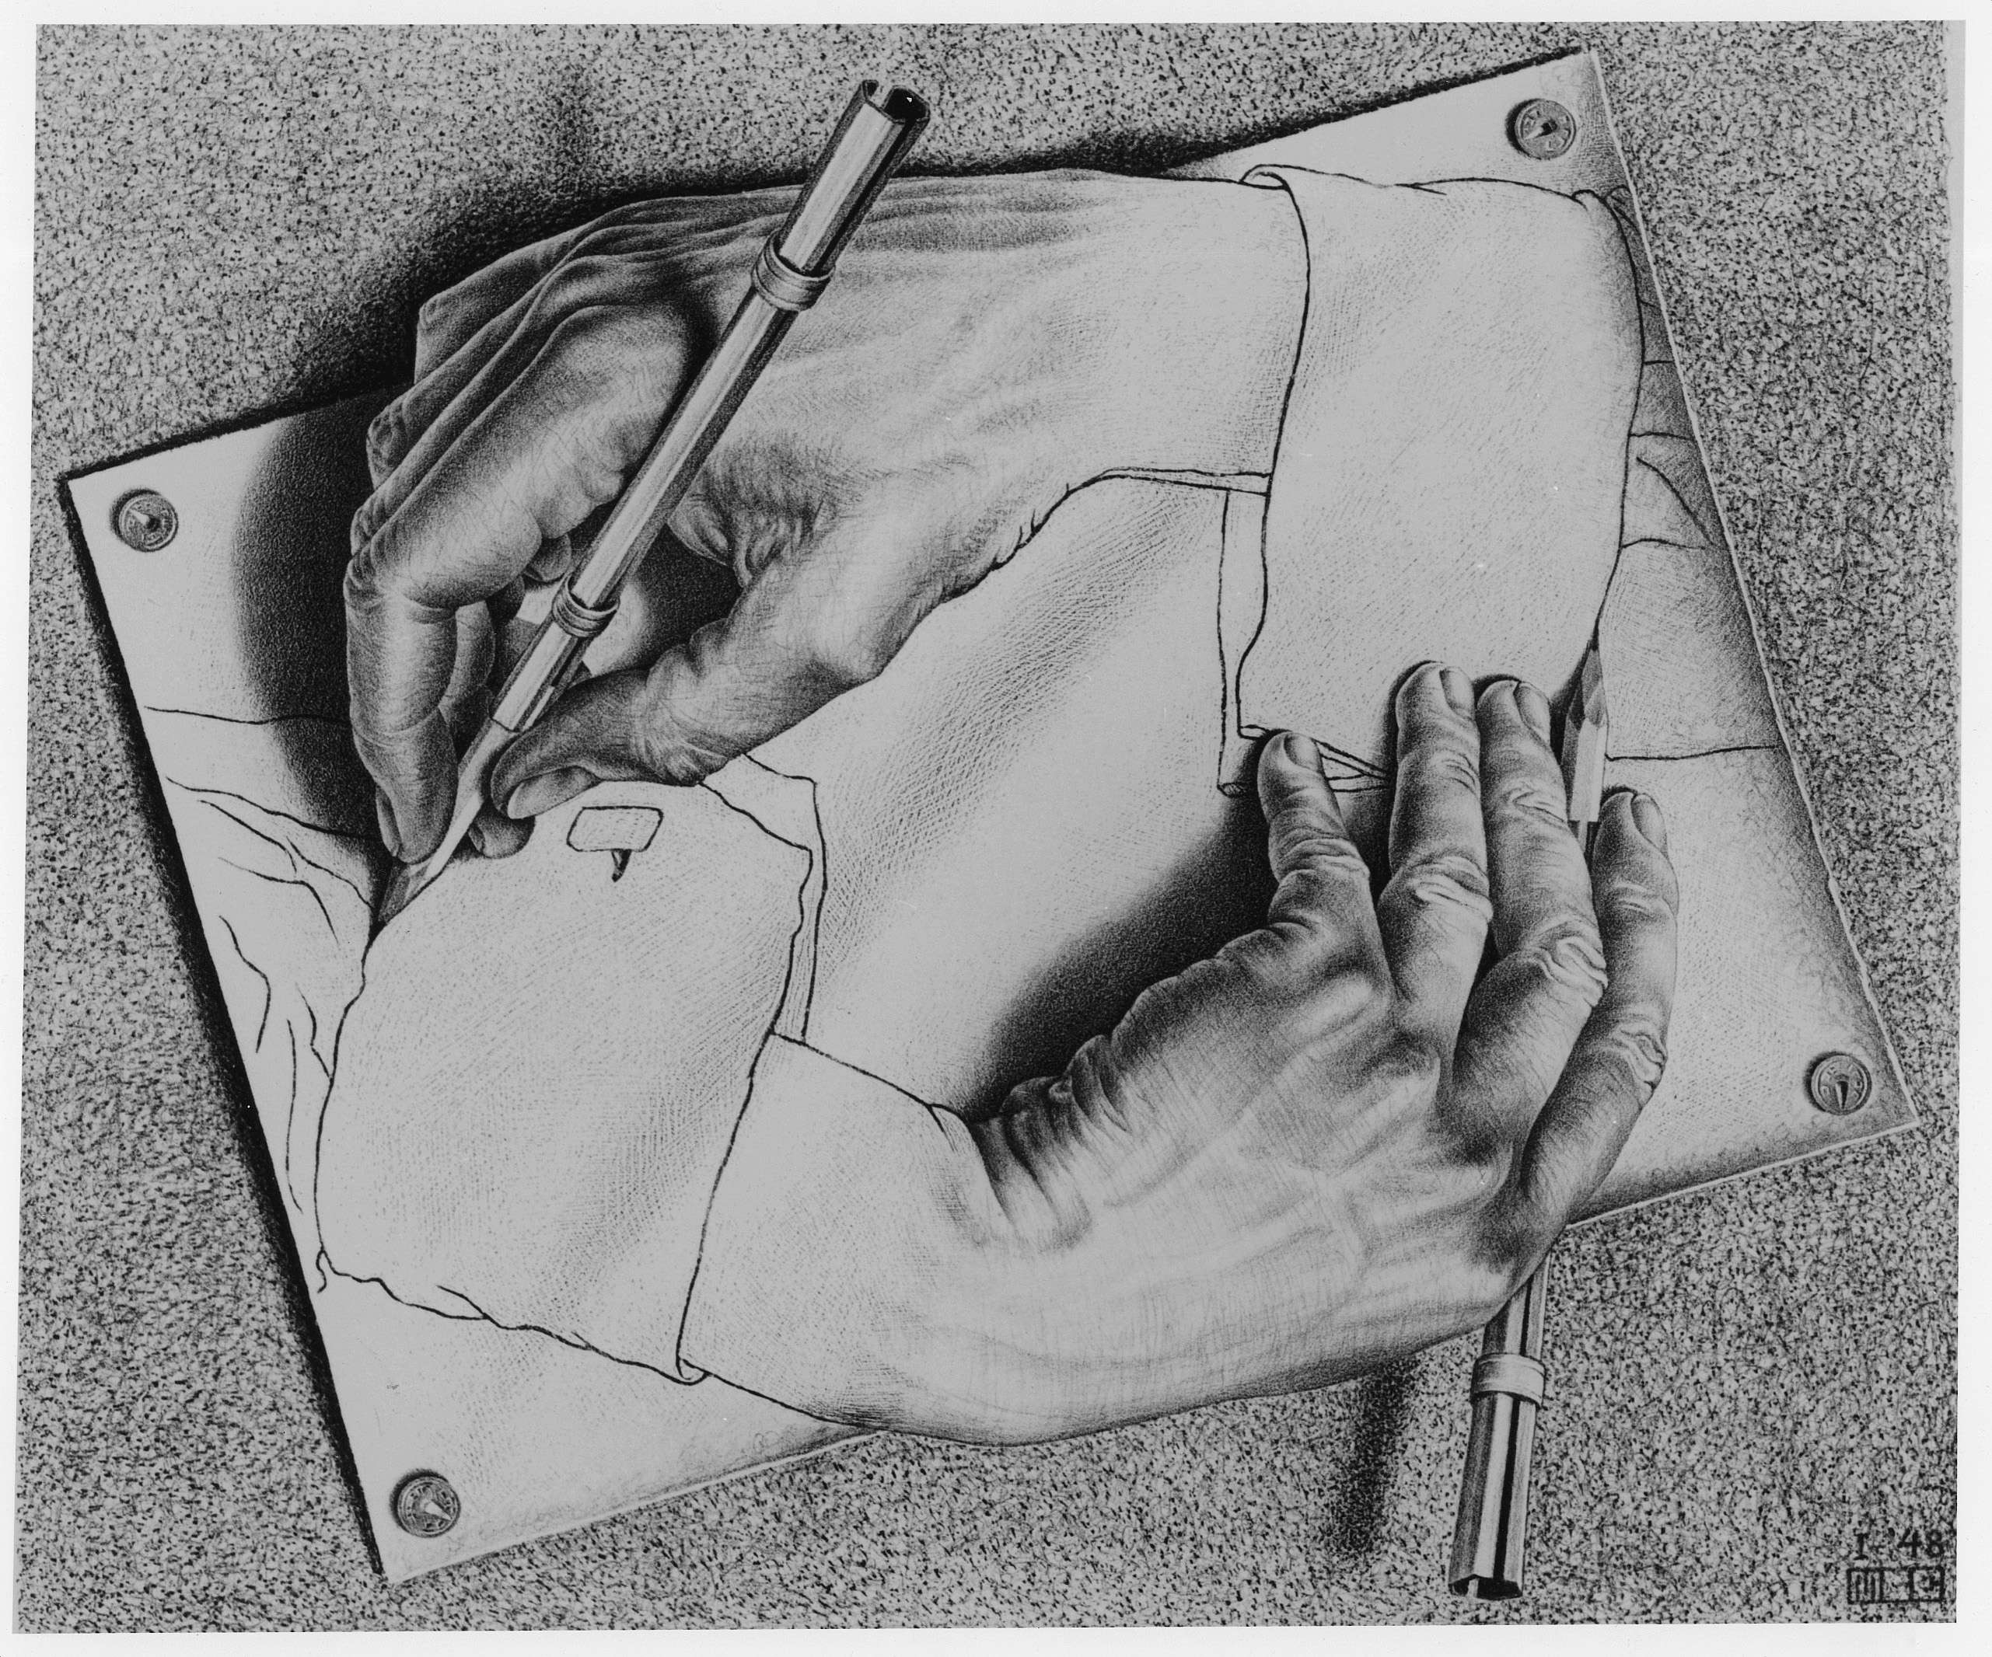
Recursion
M. C. Escher : Drawing Hands

Slide 4
Demo: vee / Fractals
python3 –i 11-Recursion.py
This uses Turtle Graphics.
The turtle module is really cool, but not something you need to learn
vee is the one recursive problem that doesn't have a base case
But fractals in general are a fun way to visualize self-similar structures
Use the following keys to play with the demo
Space to draw
C to Clear
Up to add "vee" to the functions list
Down to remove the "vee" functions from the list.
Some cool variations on vee, seen in Snap! (the language of CS10)
More Fractals

Slide 5
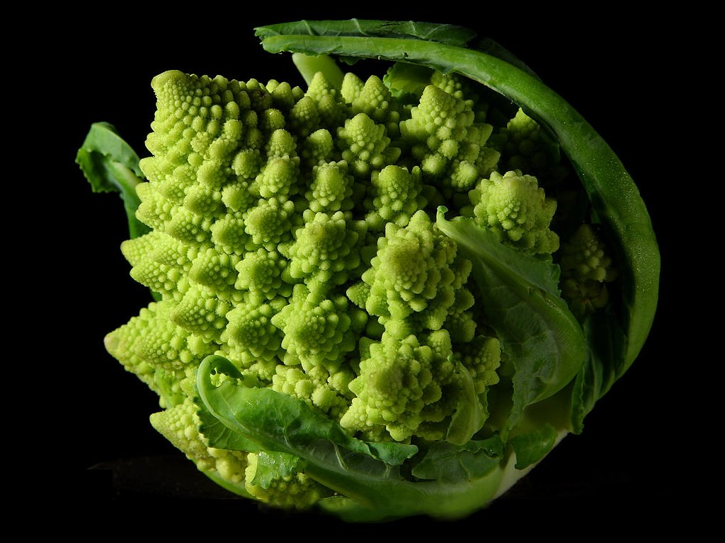
Why Recursion?
Recursive structures exist (sometimes hidden) in nature and therefore in data!
It’s mentally and sometimes computationally more efficient to process recursive structures using recursion.
Sometimes, the recursive definition is easier to understand or write, even if it is computationally slower.
Fractals are definitely easily to think of recursively!

Slide 6
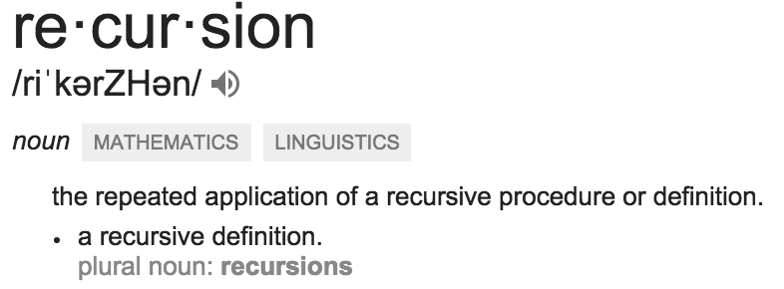
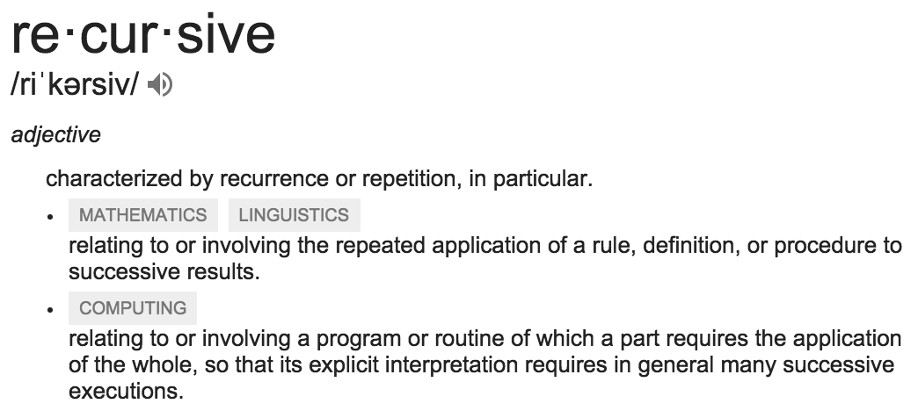
Today: Recursion
Recursive function calls itself, directly or indirectly

Slide 7
Recursion In Practice
We will use a function to solve smaller sub-problems
Compared to a for-loop, while loop, we will not directly specify how many times we need to make a function call.

Slide 8
Demo: Countdown
def countdown(n):
if n == 0:
print('Blastoff!')
else:
# … what goes here?

Slide 9
Demo: Countdown
def countdown(n):
if n == 0:
print('Blastoff!')
else:
print(n)
countdown(n - 1)

Slide 10
The Recursive Process
Recursive solutions involve two major parts:
Base case(s), the problem is simple enough to be solved directly
Recursive case(s). A recursive case has three components:
Divide the problem into one or more simpler or smaller parts
Invoke the function (recursively) on each part, and
Combine the solutions of the parts into a solution for the problem.

Slide 11
Recursion

Slide 12
Learning Objectives
Compare Recursion and Iteration to each other
Translate some simple functions from one method to another
Write a recursive function
Understand the base case and a recursive case

Slide 13
Palindromes
Palindromes are the same word forwards and backwards.
Python has some tricks, but how could we build this?
palindrome = lambda w: w == w[::-1]
[::-1] is a slicing shortcut [0:len(w):-1] to reverse items.
Let's write Reverse:
def reverse(s):
result = ''
for letter in s:
result = letter + result
return result
def reverse_while(s):
"""
>>> reverse_while('hello')
'olleh'
"""
result = ''
while s:
first = s[0]
s = s[1:] # remove the first letter
result = first + result
return result

Slide 14
Fun Palindromes
C88C
racecar
LOL
radar
a man a plan a canal panama
aibohphobia 😈
The fear of palindromes.
https://czechtheworld.com/best-palindromes/#palindrome-words

Slide 15
Writing Reverse Recursively
def reverse(s):
if not s:
return ''
return 'TODO'
def palindrome(word):
return word == reverse(word)

Slide 16
How should reverse work?
Our algorithm in words:
Take the first letter, put it at the end
The beginning of the string is the reverse of the rest.
reverse('ABC')
→ reverse('BC') + 'A'
→ reverse('C') + 'B' + 'A
→ 'C' + 'B' + 'A
→ 'CBA'

Slide 17
reverse recursive
def reverse(s):
if not s:
return ''
return reverse(s[1:]) + s[0]
def palindrome(word):
return word == reverse(word)
Recursive Case

Slide 18
Iteration vs Recursion: Sum Numbers
For loop:
def sum(n):
s=0
for i in range(0,n+1):
s=s+i
return s

Slide 19
Iteration vs Recursion: Sum Numbers
While loop:
def sum(n):
s=0
i=0
while i<n:
i=i+1
s=s+i
return s

Slide 20
Iteration vs Recursion: Sum Numbers
Recursion:
def sum(n):
if n == 0:
return 0
return n+sum(n-1)

Slide 21
Iteration vs Recursion: Cheating!
Sometimes it’s best to just use a formula! But that’s not always the point. ☺
def sum(n):
return (n * (n + 1)) / 2

Slide 22
The Recursive Process
Recursive solutions involve two major parts:
Base case(s), the problem is simple enough to be solved directly
Recursive case(s). A recursive case has three components:
Divide the problem into one or more simpler or smaller parts
Invoke the function (recursively) on each part, and
Combine the solutions of the parts into a solution for the problem.

Slide 23
Review: Functions
def <function name> (<argument list>) :
expression
return
def concat(str1, str2):
return str1+str2;
concat(“Hello”,”World”)
Generalizes an expression or set of statements to apply to lots of instances of the problem
A function should do one thing well

Slide 24
How does it work?
Each recursive call gets its own local variables
Just like any other function call
Computes its result (possibly using additional calls)
Just like any other function call
Returns its result and returns control to its caller
Just like any other function call
The function that is called happens to be itself
Called on a simpler problem
Eventually stops on the simple base case

Slide 25
Another Example
indexing an element of a sequence
def first(s):
"""Return the first element in a sequence."""
return s[0]
def rest(s):
"""Return all elements in a sequence after the first"""
return s[1:]
def min_r(s):
“””Return minimum value in a sequence.”””
if len(s) == 1:
return first(s)
else:
return min(first(s), min_r(rest(s)))
Slicing a sequence of elements
Base Case
Recursive Case
Recursion over sequence length

Slide 26
Recall: Iteration
1. Initialize the “base” case of no iterations
2. Starting value
def sum_of_squares(n):
accum = 0
for i in range(1,n+1):
accum = accum + i*i
return accum
3. Ending value
4. New loop variable value

Slide 27
Recursion Key concepts – by example
1. Test for simple “base” case
2. Solution in simple “base” case
def sum_of_squares(n):
if n < 1:
return 0
else:
return sum_of_squares(n-1) + n**2
3. Assume recusive solution to simpler problem
4. ”Combine” the simpler part of the solution, with the recursive case

Slide 28
In words
The sum of no numbers is zero
The sum of 1² through n² is the
sum of 1² through (n-1⁾²
plus n²
def sum_of_squares(n):
if n < 1:
return 0
else:
return sum_of_squares(n-1) + n**2

Slide 29
Why does it work
sum_of_squares(3)
# sum_of_squares(3) => sum_of_squares(2) + 3**2
# => sum_of_squares(1) + 2**2 + 3**2
# => sum_of_squares(0) + 1**2 + 2**2 + 3**2
# => 0 + 1**2 + 2**2 + 3**2 = 14

Slide 30
Questions
In what order do we sum the squares ?
How does this compare to iterative approach ?
def sum_of_squares(n):
accum = 0
for i in range(1,n+1):
accum = accum + i*i
return accum
def sum_of_squares(n):
if n < 1:
return 0
else:
return sum_of_squares(n-1) + n**2
def sum_of_squares(n):
if n < 1:
return 0
else:
return n**2 + sum_of_squares(n-1)

Slide 31
Trust …
The recursive “leap of faith” works as long as we hit the base case eventually
What happens if we don’t?

Slide 32
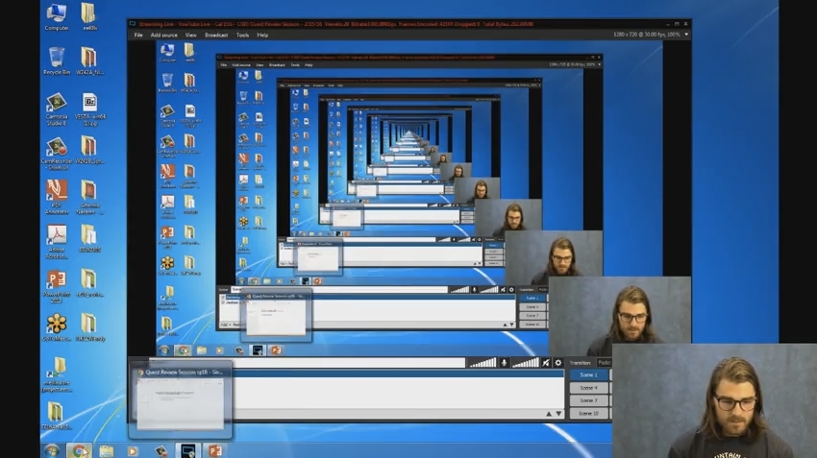
Recursion (unwanted)

Slide 33
Why Recursion?
“After Abstraction, Recursion is probably the 2nd biggest idea in this course”
“It’s tremendously useful when the problem is self-similar”
“It’s no more powerful than iteration, but often leads to more concise & better code”
“It’s more ‘mathematical’”
“It embodies the beauty and joy of computing”
…

Slide 34
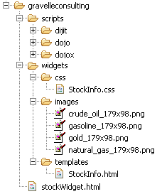
Example I
List all items on your hard disk
Files
Folders contain
Files
Folders
Recursion!

Slide 35
Tail Recursion
All the work happens on the way down the recursion
On the way back up, just return
def sum_up_squares(i, n, accum):
"""Sum the squares from i to n in incr. order"""
if i > n:
return accum
else:
return sum_up_squares(i+1, n, accum + i**2)
>>> sum_up_squares(1,3,0)
14
Base Case
Tail Recursive Case

Slide 36
Local variables
def sum_of_squares(n):
n_squared = n**2
if n < 1:
return 0
else:
return n_squared + sum_of_squares(n-1)
Each call has its own “frame” of local variables
What about globals?
Let’s see the environment diagrams (next lecture)
https://goo.gl/CiFaUJ

Slide 37
For Homework
fibonacci(n) = fibonacci(n-1) + fibonacci(n-2)
where fibonacci(1) == fibonacci(0) == 1

Slide 38
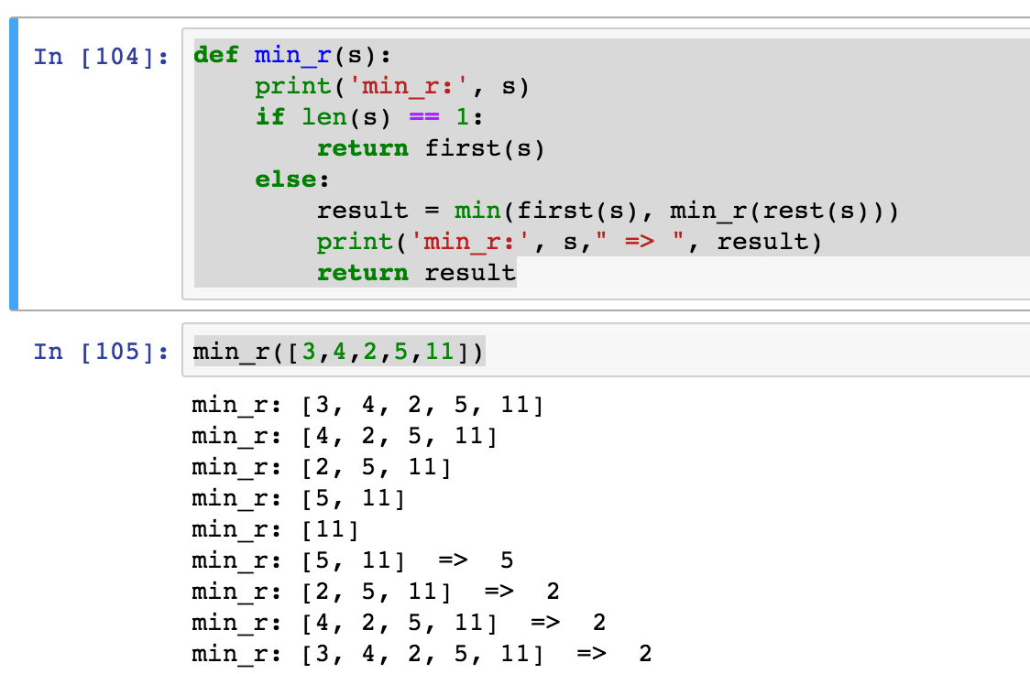
Visualize its behavior (print)
What about sum?
Don’t confuse print with return value

Slide 39
Recursion
Recursion is…
A) Less powerful than a for loop B) As powerful as a for loop C) As powerful as a while loop D) More powerful than a while loop E) Just different all together
Solution: C) Any recursion can be formulated as a while loop and any while loop can be formulated as a recursion (with a global variable).

Slide 40
Why Recursion? More Reasons
Recursive structures exist (sometimes hidden) in nature and therefore in data!
It’s mentally and sometimes computationally more efficient to process recursive structures using recursion.

